Slide 1

SoTL - driven evolution of a university probability course.
J. Todd Lee – tlee@elon.edu
Elon University
Friday January 17, 2020, 3:00 p.m.-4:55 p.m. MAA Contributed Paper Session on
Scholarship on Teaching and Learning Statistics.
Notes:
Thanks to Lisa Carnell

Slide 2
What is our Probability Course?
Once upon a time, the only “Stats” class
Prob Theory now pre-req for Stats Theory
Required for math education licensure
Engineering program growing fast
Junior level math and stats class

Slide 3
Probability Class - Content
H. Pishro-Nik, "Introduction to probability, statistics, and random processes",
available at https://www.probabilitycourse.com, Kappa Research LLC, 2014.

Slide 4
Probability Class - Content
History, Axioms, Sets, Counting
Interpretations
Random Variable and Distributions
Expected Value
Inequalities
Moment Generating Functions
Limit Theorems

Slide 5
Granular Density Metaphor
A experiment is interpreted as a complex, high-parameter process that results in some discrete or continuous outcome set.
The parameter space is partitioned into tiny pieces (grains) that can each be considered “Equiprobable”. This partition is fine enough to make the total unit of “probability sand” contain enough grains to be unreasonable to count.

Slide 6

Granular Density Metaphor

Slide 7
Granular Density Metaphor
Keller. (1986) The Probability of Heads. American Mathematical Monthly, 93:191-197
Diaconis, Holmes, Montgomery. (2007) Dynamical Bias in the Coin Toss. SIAM Review, 49:2:211–235

Slide 8
Granular Density Metaphor
2009 – Technology Innovations in Statistics Education
2014 – ICOTS 09
2018 – ICOTS 10

Slide 9
Interviews
What is a PDF?
3/5’s of rolling a 4?
Paper clip maker distribution of wire diameter

Slide 10
Micro-Summary
What is a PDF?
Cautiously satisfied
Need to connect more to CDF
3/5’s of rolling a 4?

Slide 11
Micro-Summary
Need to connect more to CDF
3/5’s of rolling a 4?
Frequentist interpretation, but mindful of the probabilistic limit
Make day project

Slide 12
Micro-Summary
Need to connect more to CDF
3/5’s of rolling a 4 as a day project
Paper clip Diameter
Given time and nudging, surprisingly good at filling in details and pertinent questions
Curriculum does not really address non- standard distributions

Slide 13
Micro-Response
Need to connect more to CDF
3/5’s of rolling a 4 as a day project
Empirical distributions via multi-kernal approach

Slide 14
Micro-Response
Need to connect more to CDF
3/5’s of rolling a 4 as a day project
Empirical distributions via kernel density estimation
Promote value of moment generating functions

Slide 15
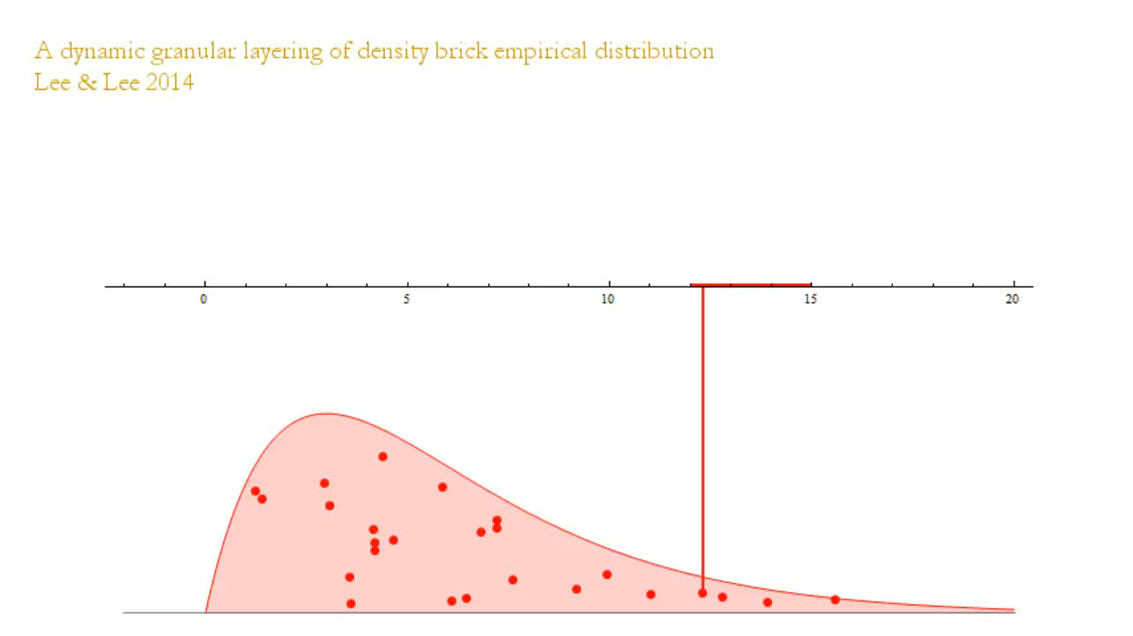
Granular Histogram

Slide 16
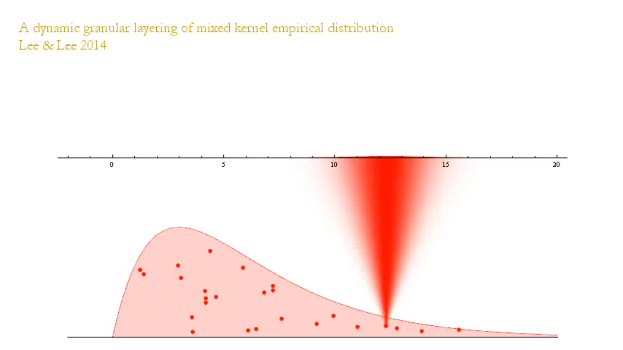
Mixed Kernel Granular Emp.

Slide 17
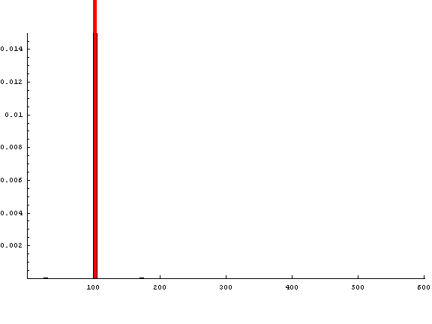
Need for MGFs

Slide 18
Need for MGFs

Slide 19
Need for MGFs

Slide 20
Need for MGFs

Slide 21
PDF
Different shapes represent different distributions
Curve that outlines the top of sand

Slide 22
3/5 probability of “4” (a)
Statement of empirical distribution
Comparative likeliness
Exact versus close
3/5 versus 0.6
Guess

Slide 23
3/5 probability of “4” (b)
Straight-up not fair
Gives (and names) frequentist perspective, and remembers names of other interpretations. Even remembers probabilistic limit.
Gives physical possibilities to cause this
Sides of zero probability (!!)

Slide 24
Range of usable diameter
Initially the area and then on horizontal axis
Wants equation of distribution
Sand DOES save the day
Interval that meets needs

Slide 25
Abstract
The growth of STEM disciplines (especially in data sciences) in middle-sized universities creates a new reality for the purpose and clients in an introductory probability course. In the initially investigated class, the instructor faced the challenge of providing a conceptual framework that is productive for the learning and application of probability to a broad range of majors (Lee, ICOTS10, 2018). The course serves as an upper-level elective for various STEM majors, a required course for math education majors, and a prerequisite for most concentrations in statistics. As with many data science classes, there is an ever-growing variation in the corridors of both prior-knowledge and future aspirations of the students. The granular density metaphor (Lee & Lee, 2014) was used as a core content element to address the needed multi-purpose structure. There is a need for reliable, primary intuitions about what probabilities “represent” in application and on how density functions work. The initial research was on the viability of using a metaphor that blends classical and subjective views on probability distributions. This paper reviews the initial findings and then turns to focus on the resulting reflections and modifications used in teaching the next iteration of the course.

